Slide 1

CS-513
Knowledge Discovery
& Data Mining Project
Telco Customer Churn - Customer Retention
Prof. Khasha Dehnad

Slide 2




Members
Aprajita Seth
Mukunth Rajendran
Vikas Bhat
Eshwar Vasudevan

Slide 3
Table of Content
Introduction
Profound Question
CRISP DM model
Business Implications
Dataset - Quicklook
Data Preparation
Outliers
Missing Values and Normalization
Converting Categorical (Nominal) data
Algorithms - Random Forest, C5.0, Naive Bayes, Decision Tree, SVM, KNN, ANN
Model Comparison using ROC curve
Conclusion

Slide 4

Introduction
Telco Customer Churn Dataset - Customer Retention
“Get closer than ever to your customers. So close that you tell them what they need well before they realize it themselves.” – Steve Jobs
The primary motive of any market is to keep customers interested and engaged, and our project is focused on finding the impact of
different variables affecting customer retention.
Our Client - Telecommunication Company ‘Telco’
Our Dataset - Telco customer CHURN
Data Source - Kaggle
https://www.kaggle.com/blastchar/telco-customer-churn

Slide 5
Profound Question
What we are predicting?
Whether the current customer will be there in the future or not?
How we are predicting?
By finding which variables impact customer retention, and then preparing the model with those variables
Which models we are using?
Classification Models- Random Forest, C5.0, Naive Bayes, Decision Tree, SVM, KNN, ANN

Slide 6
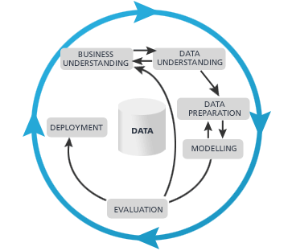
CRISP DM MODEL
Cross-Industry Standard Process for Data Mining
The CRISP-DM model provides a structured approach for planning a data mining project by dividing it into 6 major phases.
Business understanding
Data understanding
Data preparation
Modeling
Evaluation
Deployment

Slide 7
6 Phases of CRISP DM Model
STAGE ONE – BUSINESS UNDERSTANDING
Determining desired outputs, accessing current situation, determining data mining goals, producing project plan
STAGE TWO – DATA UNDERSTANDING
Describing and exploring data, verifying data quality, creating data quality report
STAGE THREE – DATA PREPARATION
Selecting data ,cleaning the data, constructing required dataset, integrating data
STAGE FOUR – MODELLING
Selecting modeling technique, generating test design, building models, assessing models
STAGE FIVE – EVALUATION
Evaluating the results, reviewing process, determining next steps
STAGE SIX – DEPLOYMENT
Planning deployment, planning monitoring and maintenance measures, producing final report, reviewing project

Slide 8
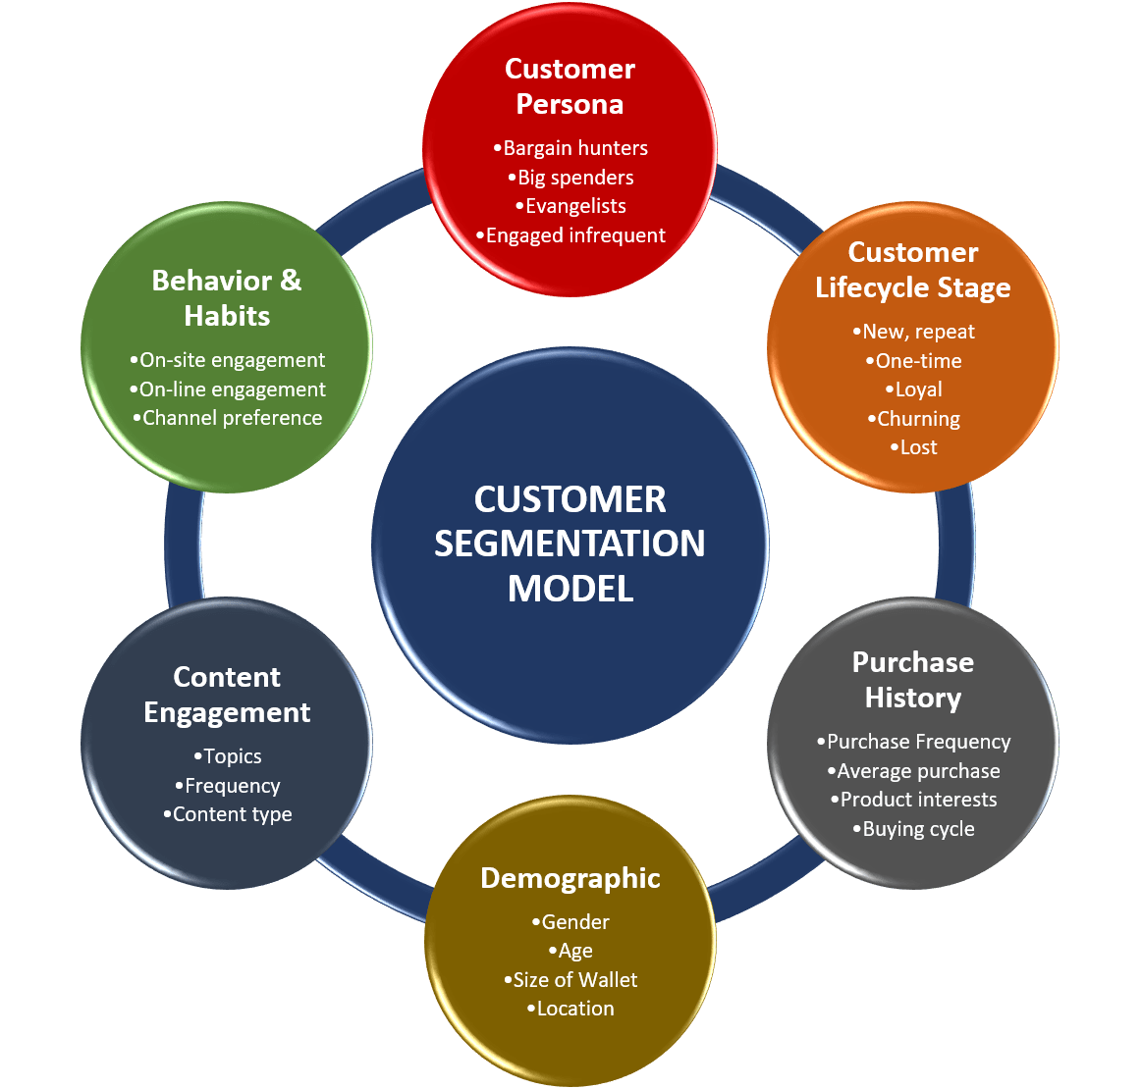
Business Implications
With the help of our project, Telco will be able to analyse attributes and behaviour of their customers to understand what individual customers are interested in.
With the advance segmentation based on multiple customer attributes,Telco will be able to understand and increase customer retention.
Engage customers in each segment more effectively based on interests throughout their lifecycle

Slide 9
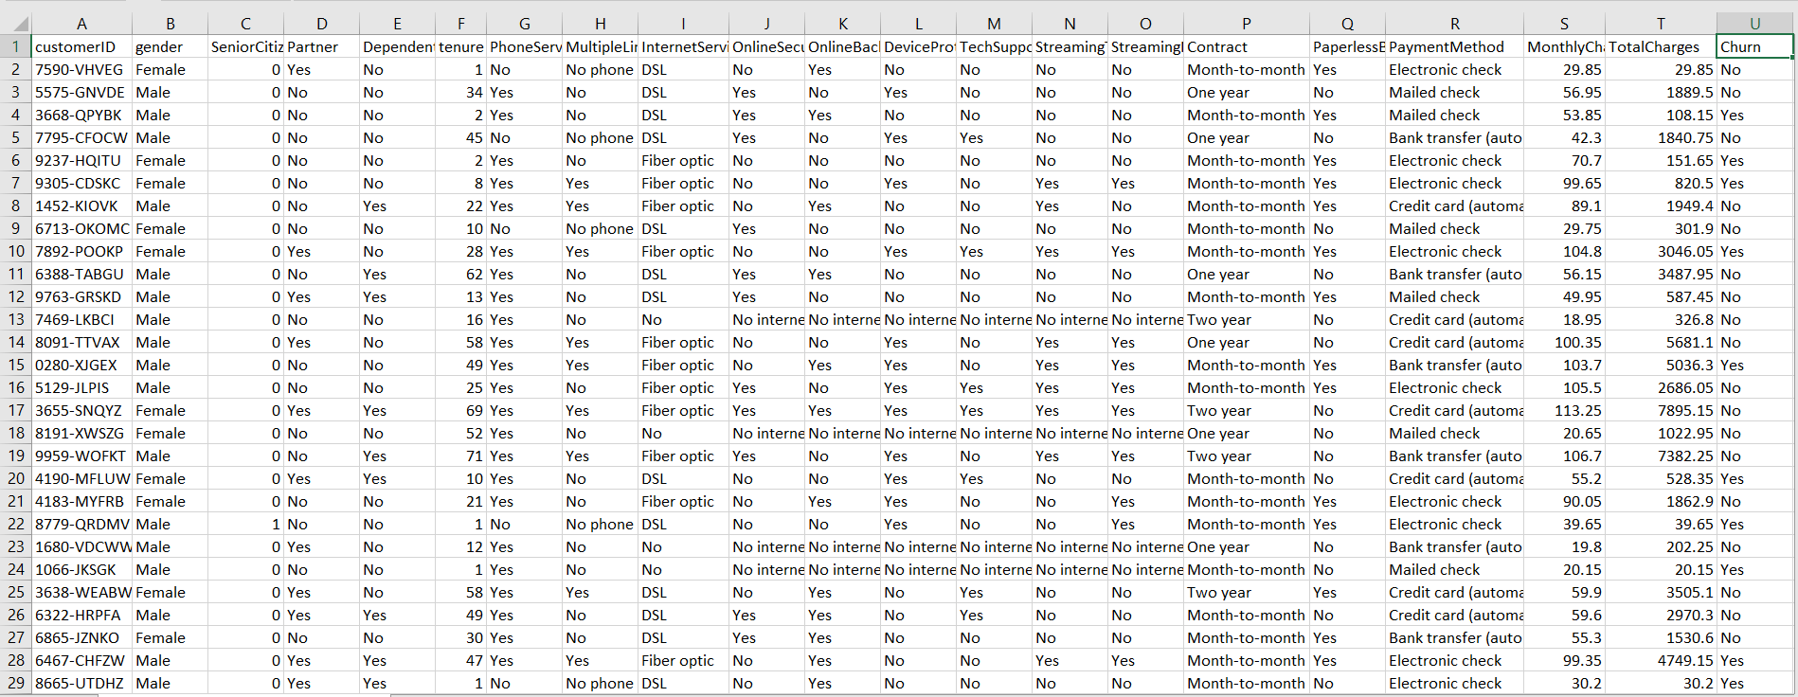
Dataset - Quick Look
The dataset consist of 7043 customer records & 21 features

Slide 10
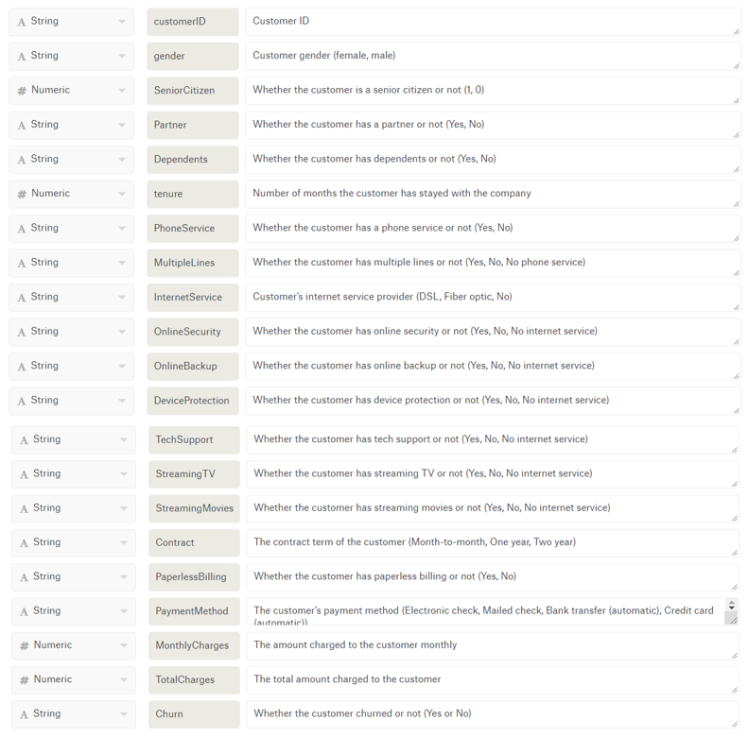

Data Preparation
-- About the dataset

Slide 11
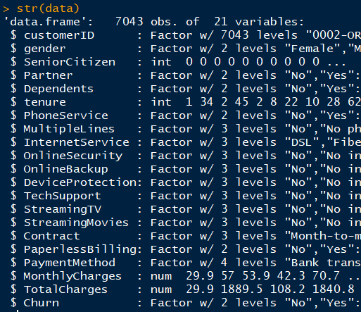
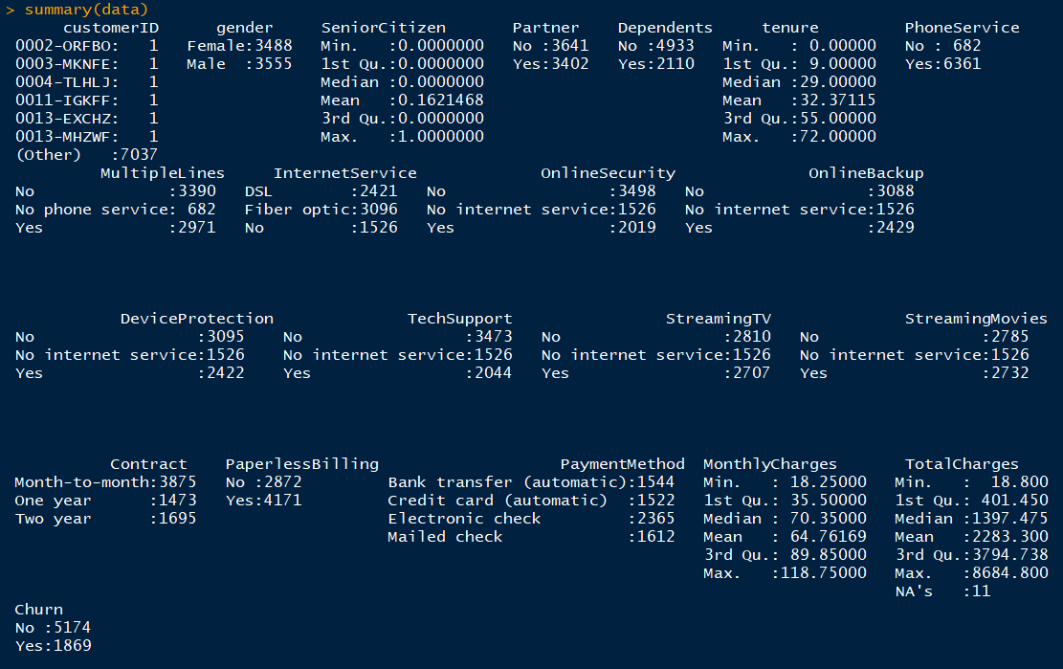
Summary of the data

Slide 12
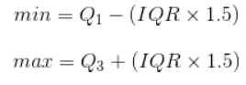
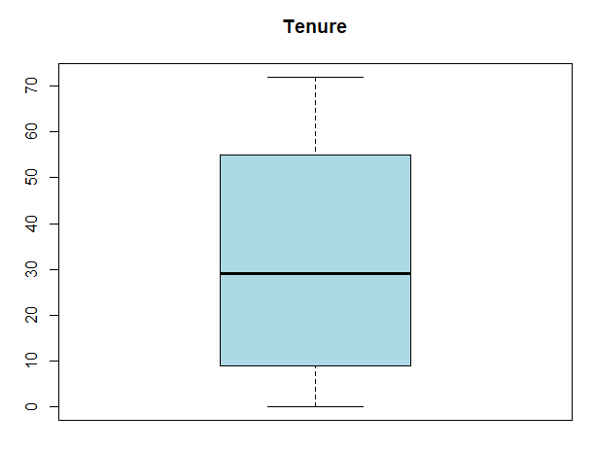
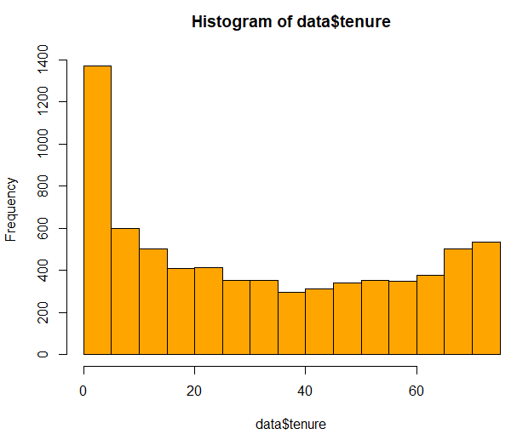
Outliers
An outliers is an observation that lies at an abnormal distance from the other values in a random sample from a population.
We use Interquartile Range Rule (IQR) to identify the outliers, this sets a Min and Max value for the range based on the 1st and 3rd quartile. It is a measure of variability that gives the spread of the middle 50% of the data.
IQR = Q3-Q1
A point is said to be an outlier if it located below Q1 - 1.5*(IQR) or above Q3+1.5*(IQR). It is viewed as being too far from the central values to be reasonable.
We used IQR on the variable “Tenure” to identify and handle the outliers.

Slide 13
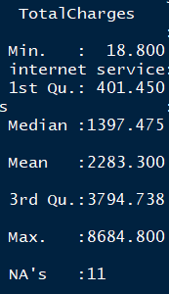
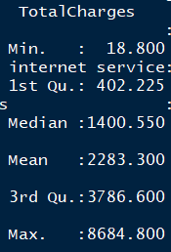
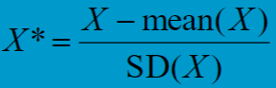
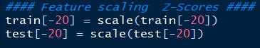
Missing values & Normalization
Handling the missing values in the Total Charges column with the mean. We didn’t want to remove NA’s, as our dataset consist of only 7043 records.
The customerID column is excluded from the dataset while training the model.
Normalization Technique - Z-score standardization - to create z-scores (standardized scores) from a variable, you would subtract the mean of all data points from each individual data point, then divide those points by the standard deviation of all points.

Slide 14
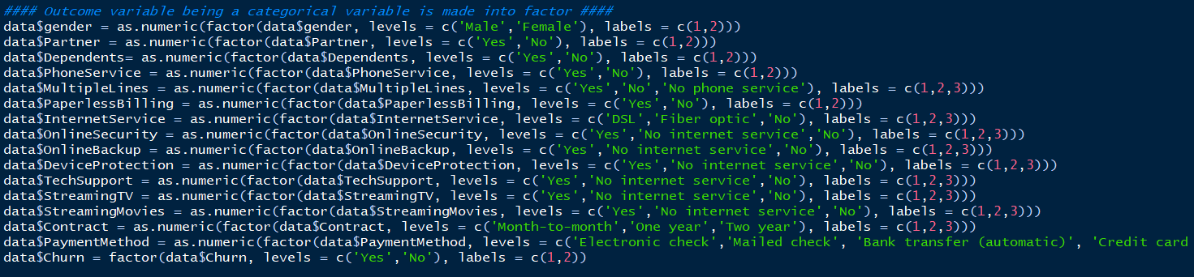
Converting Categorical (Nominal) variables
The Categorical variables are made into factor and converted into numerics. There are multiple categories in a single variable and they are represented in numbers to help us in the prediction process.

Slide 15
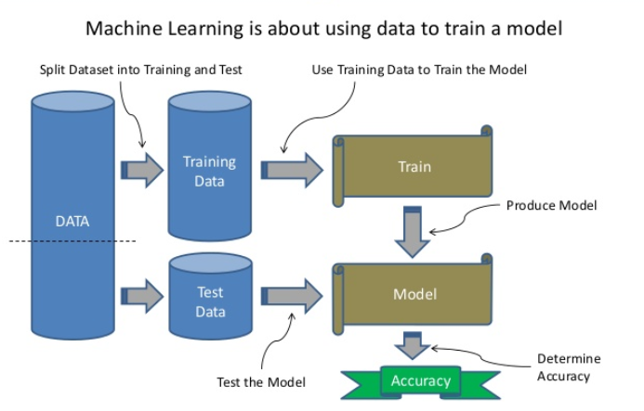
Split the dataset into Training & Test sets
After the data preparation is done, the dataset is divided into Training and Test set.
Training set = 80%
Test set = 20%
We train the model with the training data, and test the Prediction accuracy of the model using the test data.

Slide 16
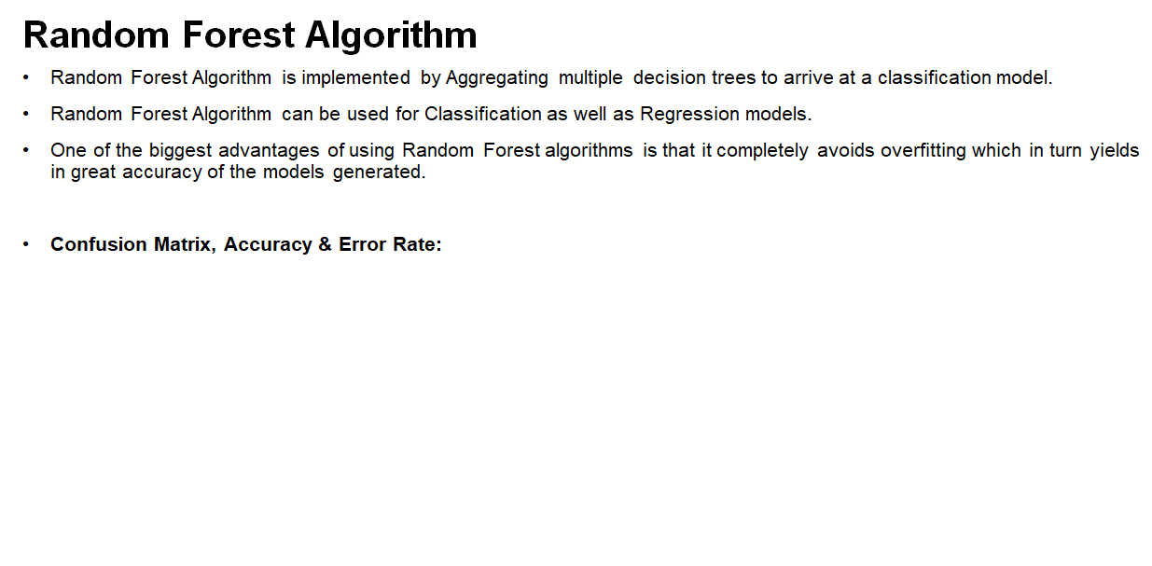
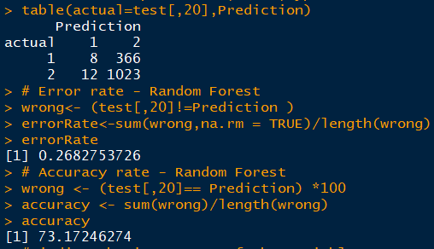
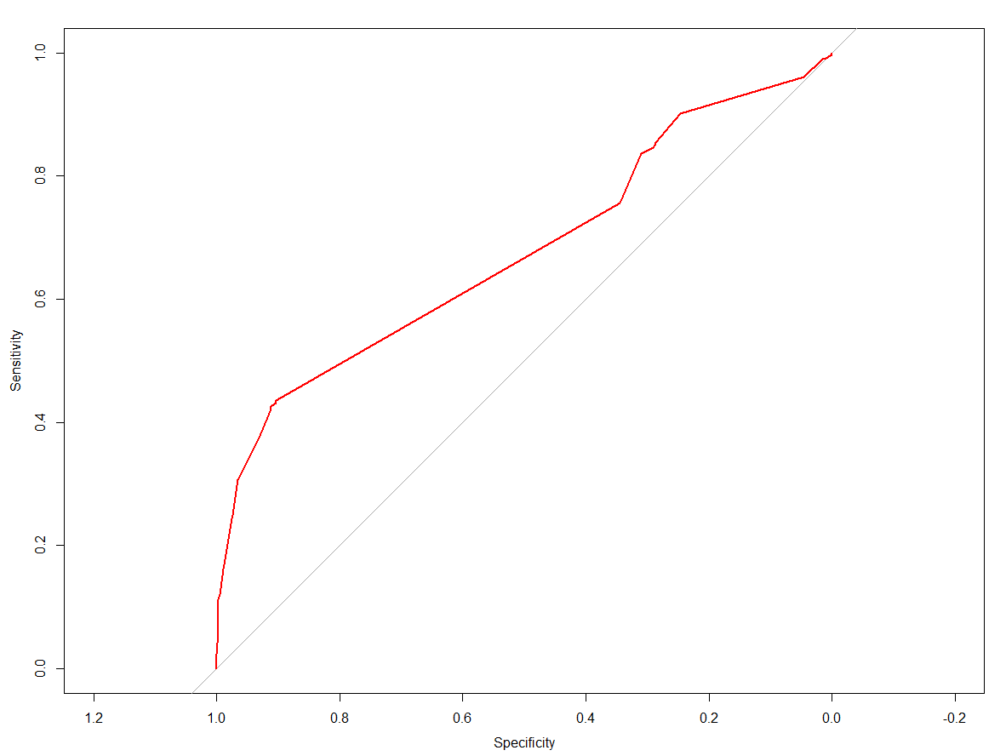

Slide 17
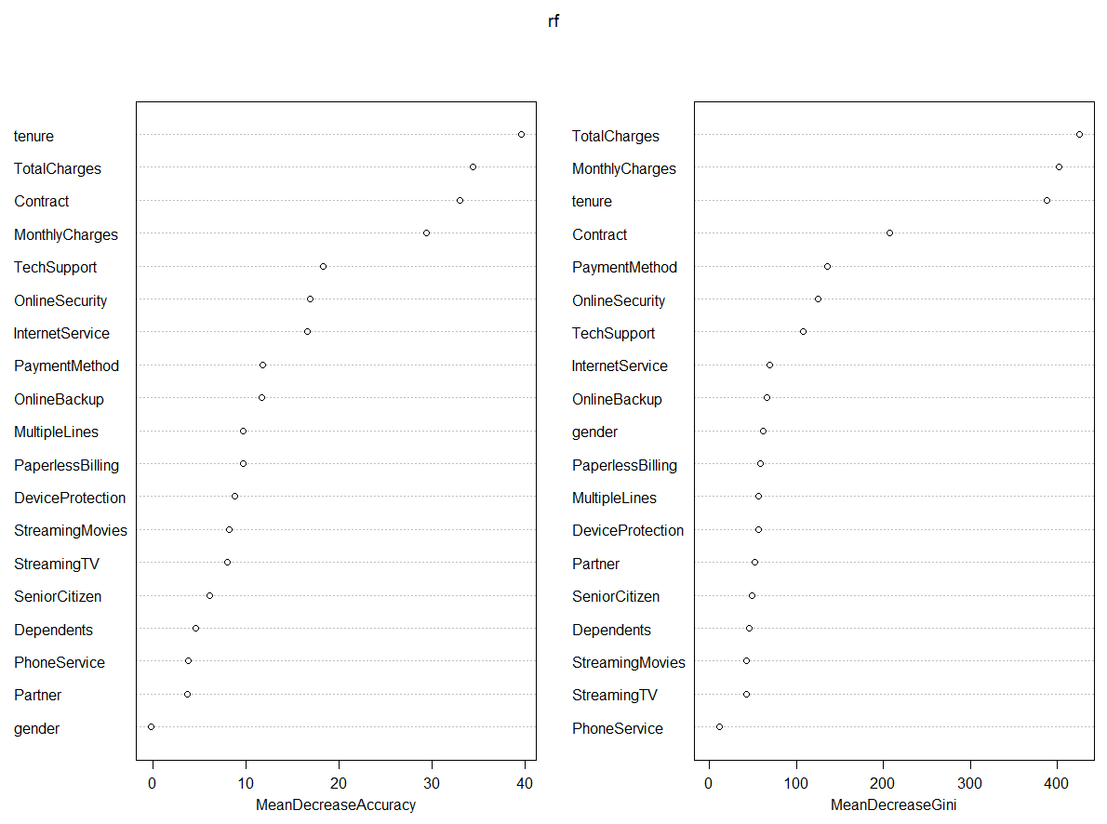
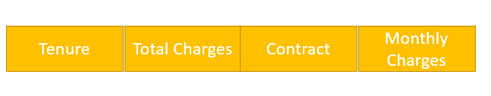
Variable Importance using Random Forest
The random forest technique examines a large ensemble of decision trees, by first generating a random sample of the original data with replacement.The plot shows each variable on the y-axis, and their importance on the x-axis. They are ordered top-to-bottom as most- to least-important.
The more the accuracy of the random forest decreases due to the exclusion (or permutation) of a single variable, the more important that variable is deemed, and therefore variables with a large mean decrease in accuracy are more important for classification of the data.
The mean decrease in Gini coefficient is a measure of how each variable contributes to the homogeneity of the nodes and leaves in the resulting random forest.

Slide 18
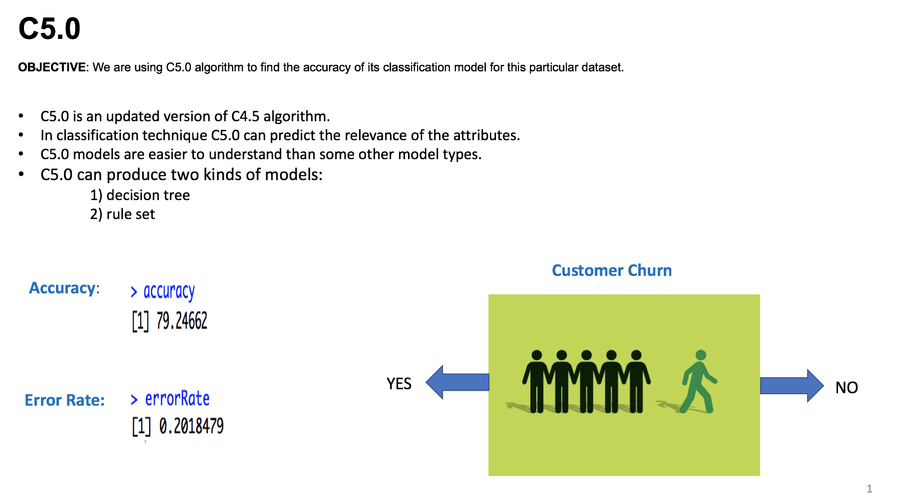
Notes:
-> C5.0 is significantly faster than C4.5 algorithm, more memory efficient, gets results efficiently with smaller decision tree
-> Since the rules derived from the model have a very straightforward interpretation.
-> We are getting an accuracy of 79.24 approx and an error rate of 20.18
-> Target is churn
-> Others are potential predictors
-> 80% training data and 20% test data

Slide 19
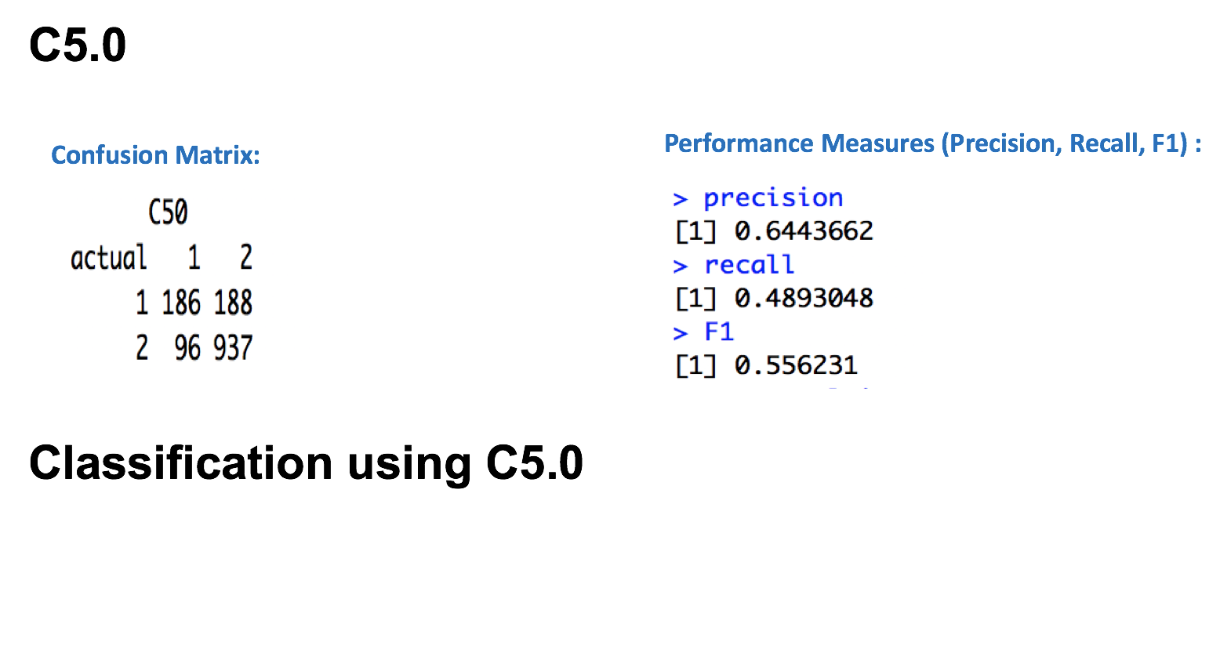
Notes:
-> predicted vs actual (TP,FN,FP,TN)

Slide 20
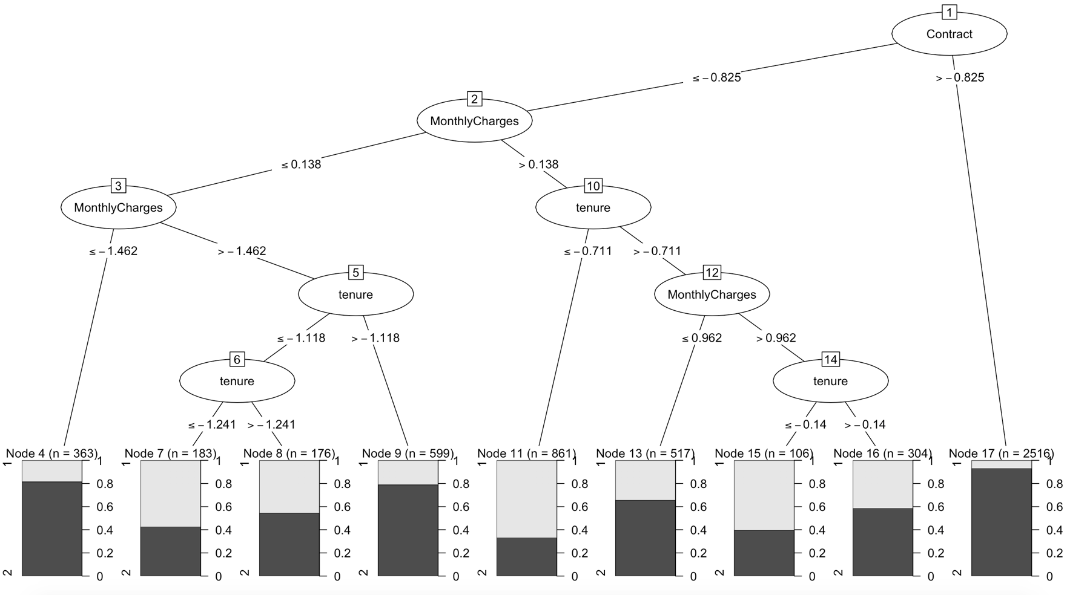

Slide 21
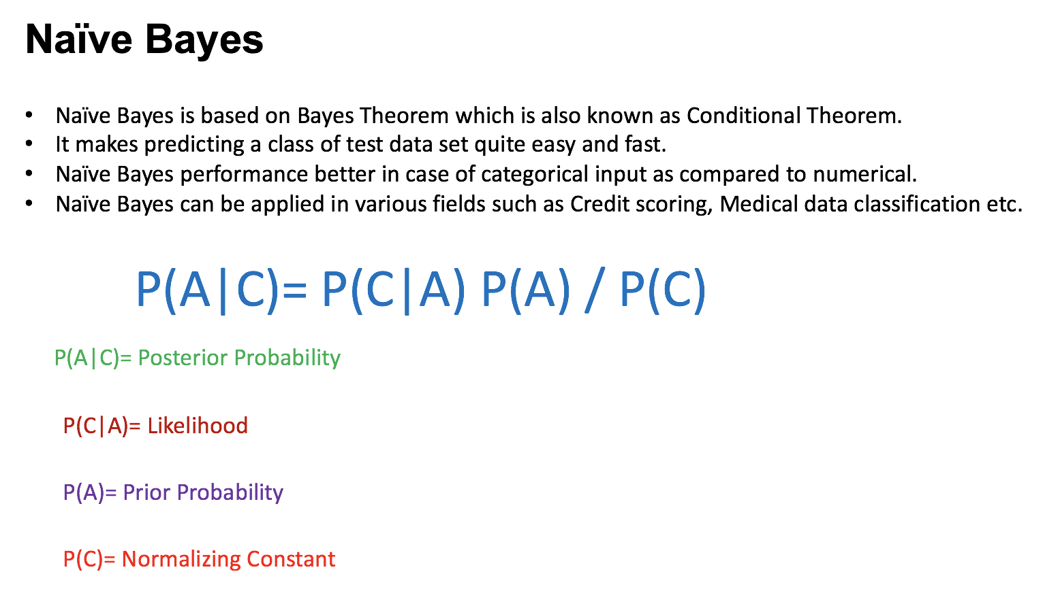
Notes:
P(A) = Degree to which we believe the model accurately describes the reality based on prior info. (evidence based)
P(C|A) = It describes how well the model predicts the data
P(C)=

Slide 22
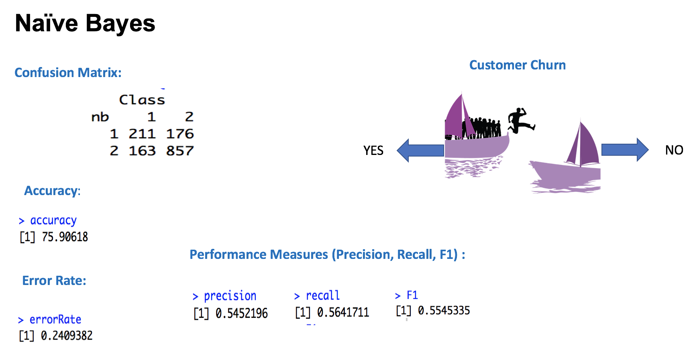

Slide 23
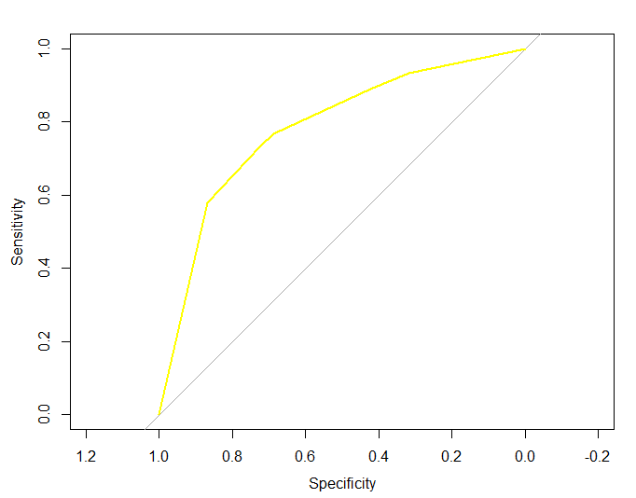
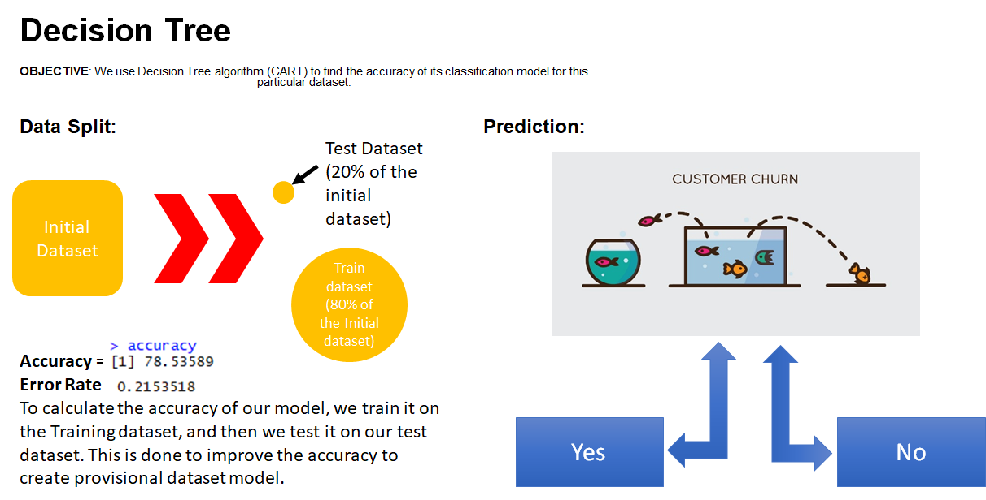
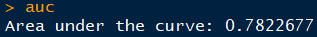
Notes:
1.The Classification and regression tree algorithm is used here to find the accuracy the accuracy of the classification model.
2.The dataset is primarily segregated to 80 train and 20 % split. We use the train_dataset to train our model and test_dataset for testing the model to improve the accuracy of the provisional dataset.
3.The split we have as far as this dataset is concerned are Churn YEs and NO.
4 .As you can see the from roc curve which maps based on specificity and sensitivity, we have an estimated area of 78% and the total area under the curve here is directly proportional in representing how sound the model is.
5. We are achieving an estimated accuracy of 78.53% and an error rate of 21.53%.

Slide 24
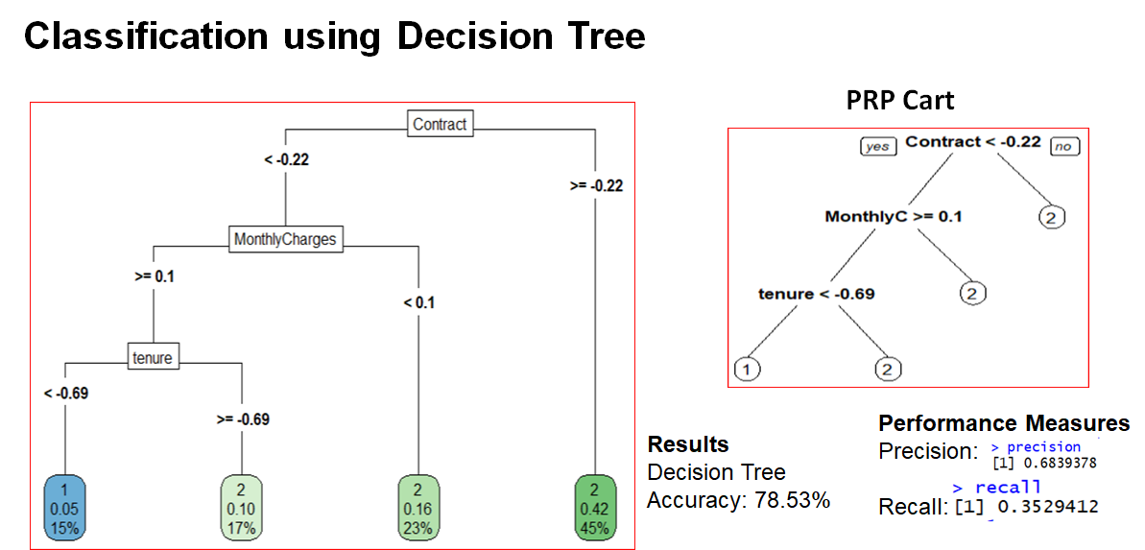
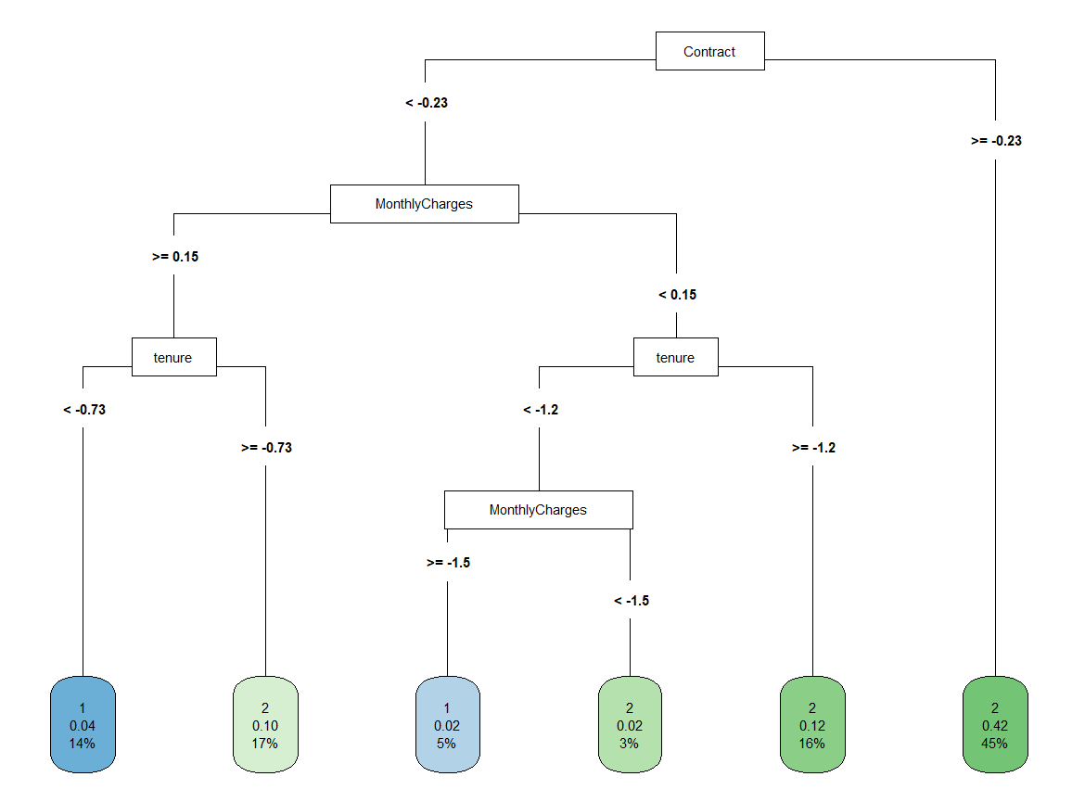
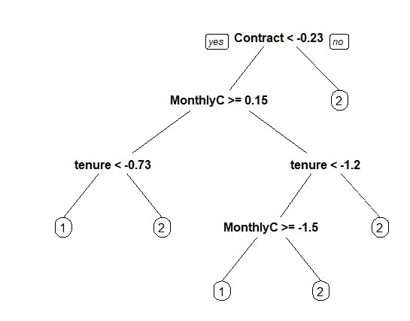
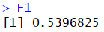
Notes:
Classification using Decision Tree
The decision is developed and split based on variable importance generated by the random forest algorithm.
Therefore the decision tree is classified based on top 3 variables affecting the accuracy of the data which in this case are: Contract , Monthly charges and Tenure.
Tree explanation and prp cart
Performance measures like Precision, recall and f1 score
Precision is the ratio of correctly predicted positive values to the total predicted observations. => TP/TP+FP
Recall on the other hand is the ratio of the correctly predicted positive observations to the ratio of all the observations in the class YEs . =>TP/TP+FN
F1 score is generated by calculating the weighted average of the precision and recall. => 2*(recall*precision)/(recall+precision)
Accuracy is the most intuitive performance which is simply the ratio of correctly predicted observations to the total number of observations. => TP+TN/TP+TN+FP+FN
Pred: No Yes
Actual No TN FP
Yes FN TP

Slide 25
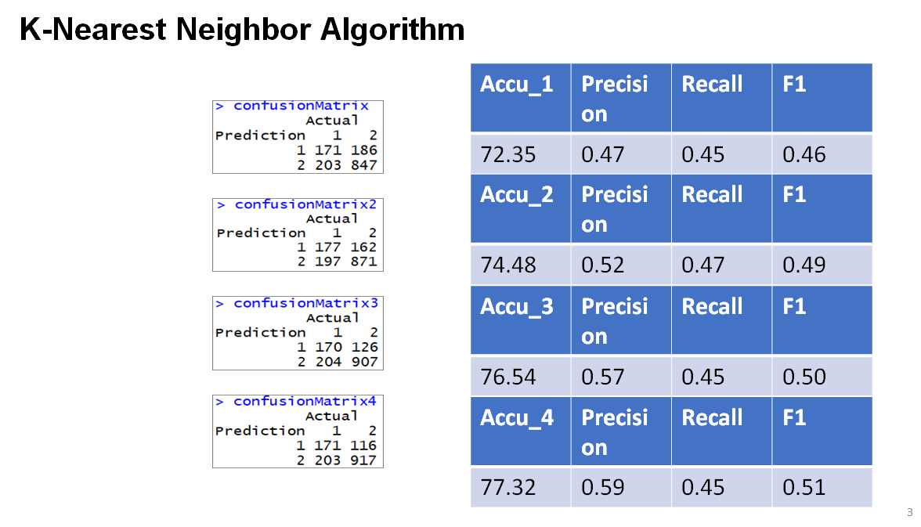
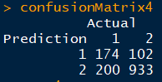
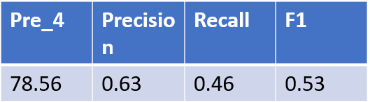
K=1
K=2
K=5
K=30
Notes:
K-nearest Neighbor Algorithm
1. KNN can be used for both regression and classification models. In this case we are using KNN for classification.
2. So basically how the K-nearest Neighbor algorithm works is given any training vector this algorithm finds the nearest neighbor classes irrespective of what their labels are.
3. The number of closest neighbors the algorithm identifies depends on the value of K passed in that particular iteration.
4. As you can see in the slides, the confusion matrix, accuracy , precision, recall and F1 is generated .
Pred: No Yes
Actual No TN FP
Yes FN TP

Slide 26
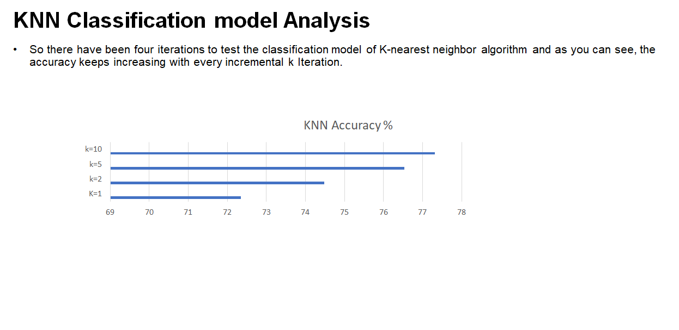
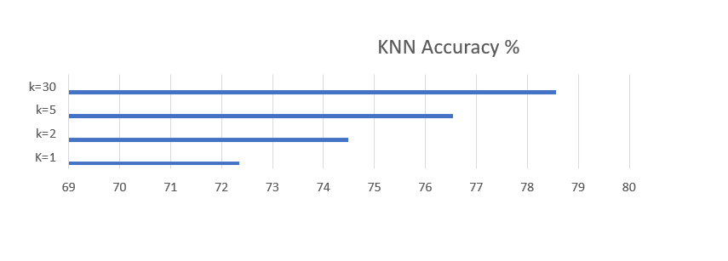
Notes:
We have tested the accuracy of the classification model for different values of K in the algorithm and there seems to be a steady increase in the accuracy of the model with the increase in the K value. We have got 72.35% for K=1, 74.48% for K=2, 76.54% for K=5 and We have got the highest accuracy for the model according to knn for the k value of 30 that is : 78.56%

Slide 27
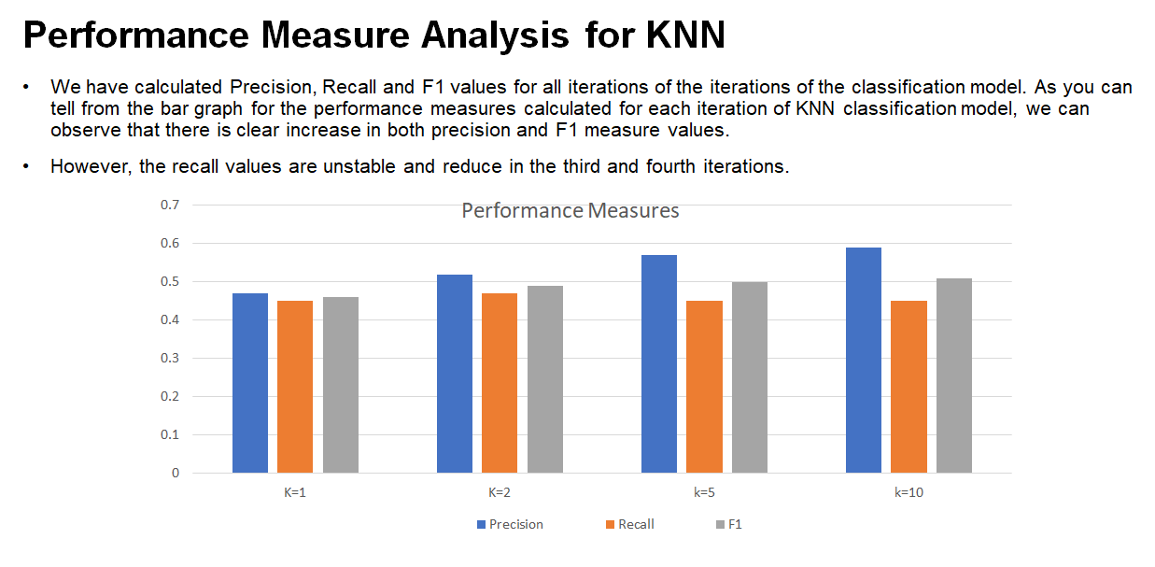
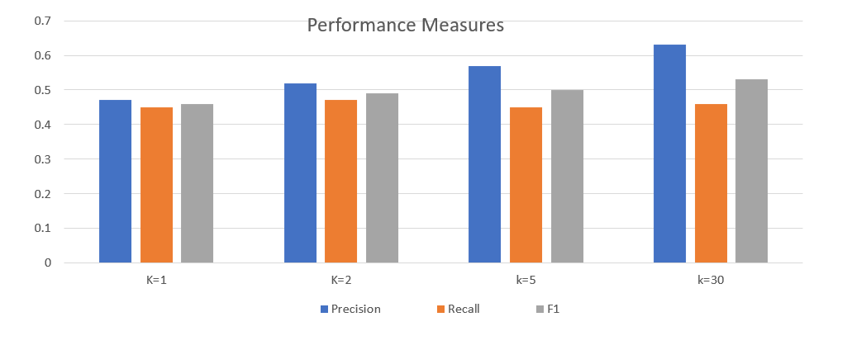
Notes:
Here we can also observe there is a steady increase in the values generated for the performance measures with every incremental value of K for the most part with the exception of recall for the third and fourth iterations

Slide 28
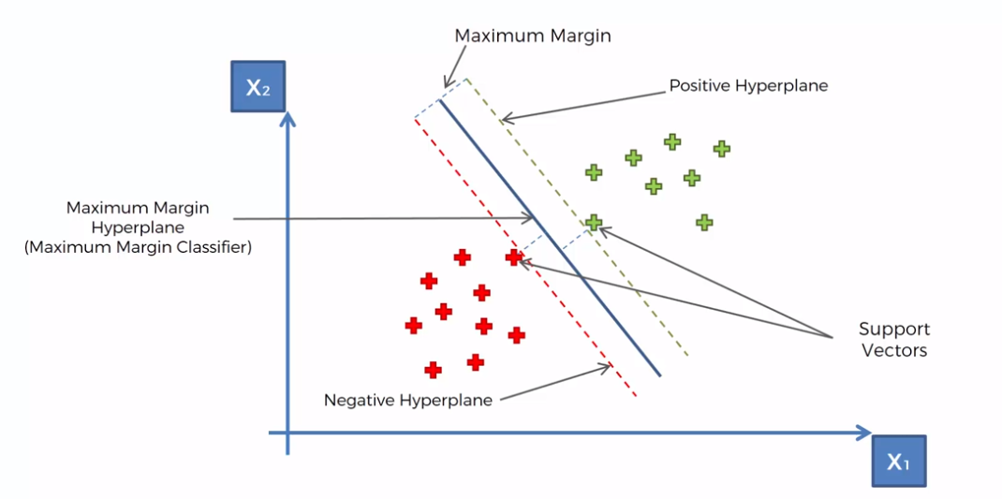
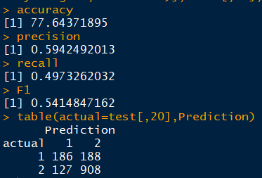
Support Vector Machine (SVM)
Support Vector Machines are Supervised learning models with associated learning algorithms that analyze data used for classification and regression analyses.
We tried to implement SVM and got an accuracy rate of 77.64%

Slide 29
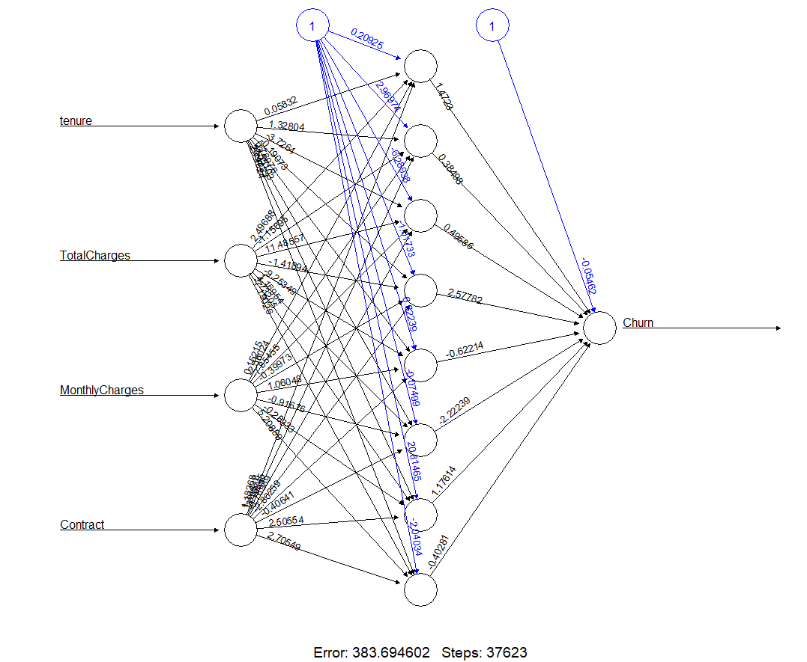
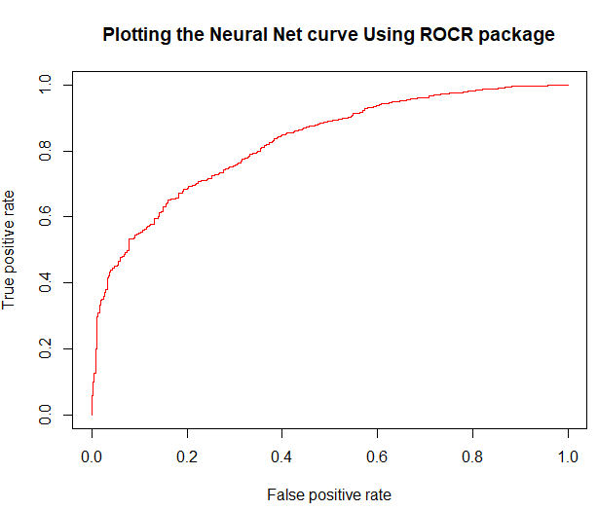
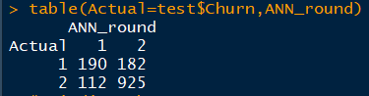
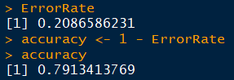
Artificial Neural Network(ANN)
An ANN is based on a collection of connected units or nodes called artificial neurons, which loosely model the neurons in a biological brain.
The neural network itself is not an algorithm, but rather a framework for many different machine learning algorithms to work together and process complex data inputs.
Confusion Matrix:
Accuracy & Error Rate:
The running time is 5 mins only.

Slide 30
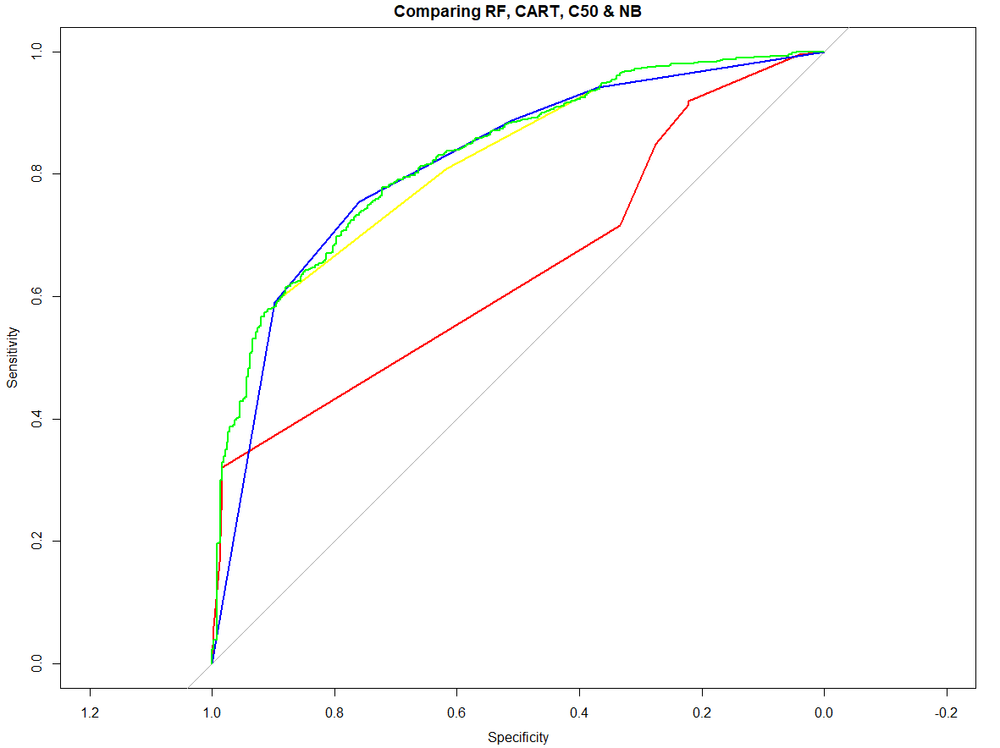
Model Comparison using ROC Curve
RF, CART, C50 & NB
The accuracy of each model are as follows:
RF = 73.172%
CART = 78.53%
C5 = 79.24%
KNN = 78.56%
NB = 69.83%
ANN = 79.13%
Thereby, stating that C5.0 does a great job with a less error rate compared to the rest, followed by ANN, which performance slightly lower as compared to the C5.0.
RF <- RED
CART <- YELLOW
C50 <- BLUE
NB <- GREEN

Slide 31
Conclusion
Best method of our problem solving is Random Forest
Less percentage error
Easy to implement
Best fit for classification problem
Cleaning the dataset was the most time consuming process (took at least 60% of the project time)
Outliers must be analysed (not ignored or removed) as they may be relevant to dataset sometimes

Slide 32

Make a customer, not a sale.

Slide 33
THANK YOU!

